Slide 1
Big Mountain Resort
Pricing Recommendations

Slide 2
Current Situation and Problem
Big Mountain Resort recently installed an additional chair lift to help increase the distribution of visitors, which increased operating costs by $1,540,000 per season.
Their ticket pricing is currently based on charging a premium above the average price of resort in its market segment
They are looking to base their ticketing price on a more data-driven strategy and/or look for strategies to cut costs to offset the price of the new lift.

Slide 3
Recommendations
Add a run, increases the vertical drop by 150 feet, and installs an additional chair lift
Would increase ticket price value
Would increase maintenance costs
It should be evaluated if the increase in maintenance costs would be worth the increase in revenue from ticket prices
Close 1 or 5 runs
Currently have one of the larger amounts of runs
Could decrease ticket price and revenue
Would decrease maintenance costs
It should be evaluated if the decrease in maintenance costs would benefit a small decrease in runs

Slide 4
Ticket Price Increase
Big Mountain is currently charging $81 per day.
Based on our data, our model determined that the price for Big Mountain Resort would be $95.87.
Even with the expected mean absolute error of $10.39, this suggests there is room for an increase.
It should be noted that our model is reliant on the idea that the other resorts used in the data have priced their tickets properly.

Slide 5
Add a run, increases the vertical drop by 150 feet, and installs an additional chair lift
Based on our models, this would support a ticket price increase of $1.99
Over the season, this could be expected to amount to $3,474,638

Slide 6
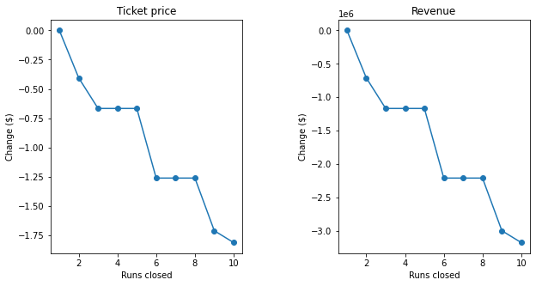
Closing Runs
Closing 1 run would not decrease ticket value or revenue
Closing 5 runs would decrease ticket value and revenue, but by the same amount as closing 3 runs and would decrease maintenance costs.

Slide 7
Summary
Big Mountain Resort can justify a ticket price increase based on the data from other resorts.
By adding a run, increasing the vertical drop by 150 feet, and installing an additional chair lift, ticket price can be increased by $1.99.
By closing 1 or 5 runs, the maintenance costs can be decreased with little or no decrease to ticket price value.

